Slide 1
Energy Management System (EMS) for Storage Cells in Electric Vehicles (EVs)
By: Andrew Tran, Hiromi Saito, & Jonathan Austin
December 2, 2021
Notes:
[J] :
_

Slide 2



The Team
Andrew Tran
Power Module Design
Hiromi Saito
Power Module Design
Jonathan Austin
Embedded Systems
Notes:
[E] :
_

Slide 3
Presentation
Outline
Background
Project Overview
Current Hardware System
Power Module Design (PMD)
Current Sense Schematic
Printed Circuit Board (PCB)
Simulation Results
Embedded Systems (ES)
DSP PWM Signals
Adapted Sorting Algorithm
PWM Output Results
Kalman Filter Research
Future Work and Considerations
Questions
Notes:
[H] : (1min)
_

Slide 4
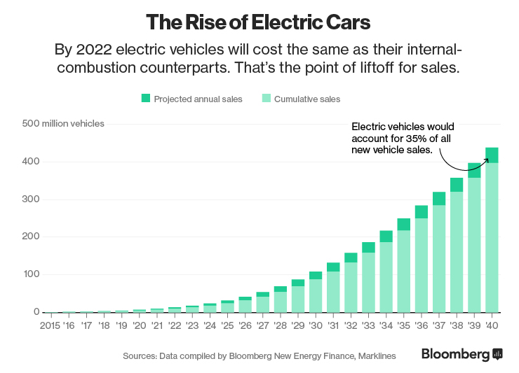
I. Background
In 2035, predicated EV market share of the car industry is roughly 35%
Maintenance of EVs require large improvement
Solution: Novel EMS of Storage Cells
[2]
Notes:
[H] :
Current standards for EVs include separate inverter and battery system which results in more expensive manufacturing and maintenance costs
As EV ownership increases, manufacturing and maintenance for EVs will increase as well.
Combining the inverter and battery system to be modular will improve costs for manufacturing and require less training for maintenance

Slide 5
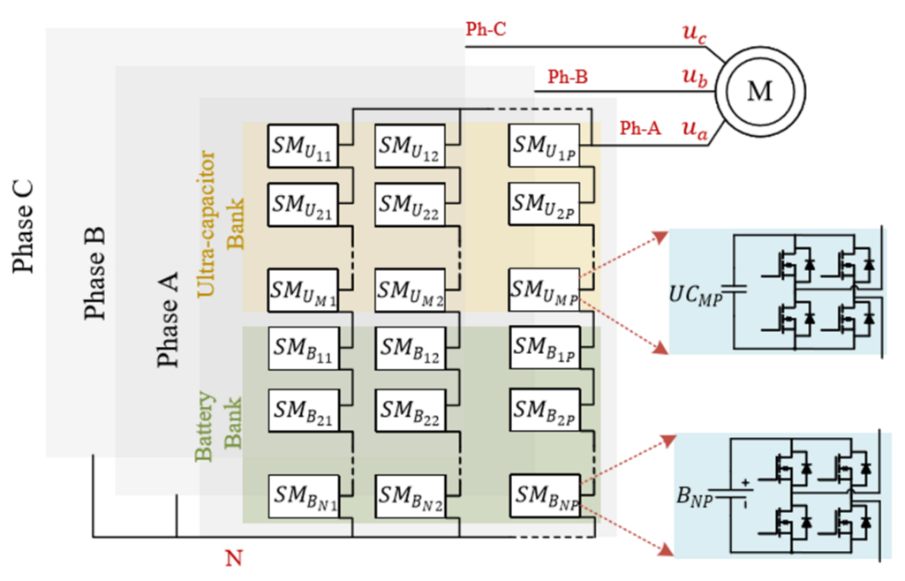
II. Project Overview
[1]
Notes:
[H] : (2min)
High Level Overview of the EMS system
H bridge subblocks connected in series and parallel to output a portion of the signal that gets sent to the transmission system
Each portion is sectioned off by phase

Slide 6
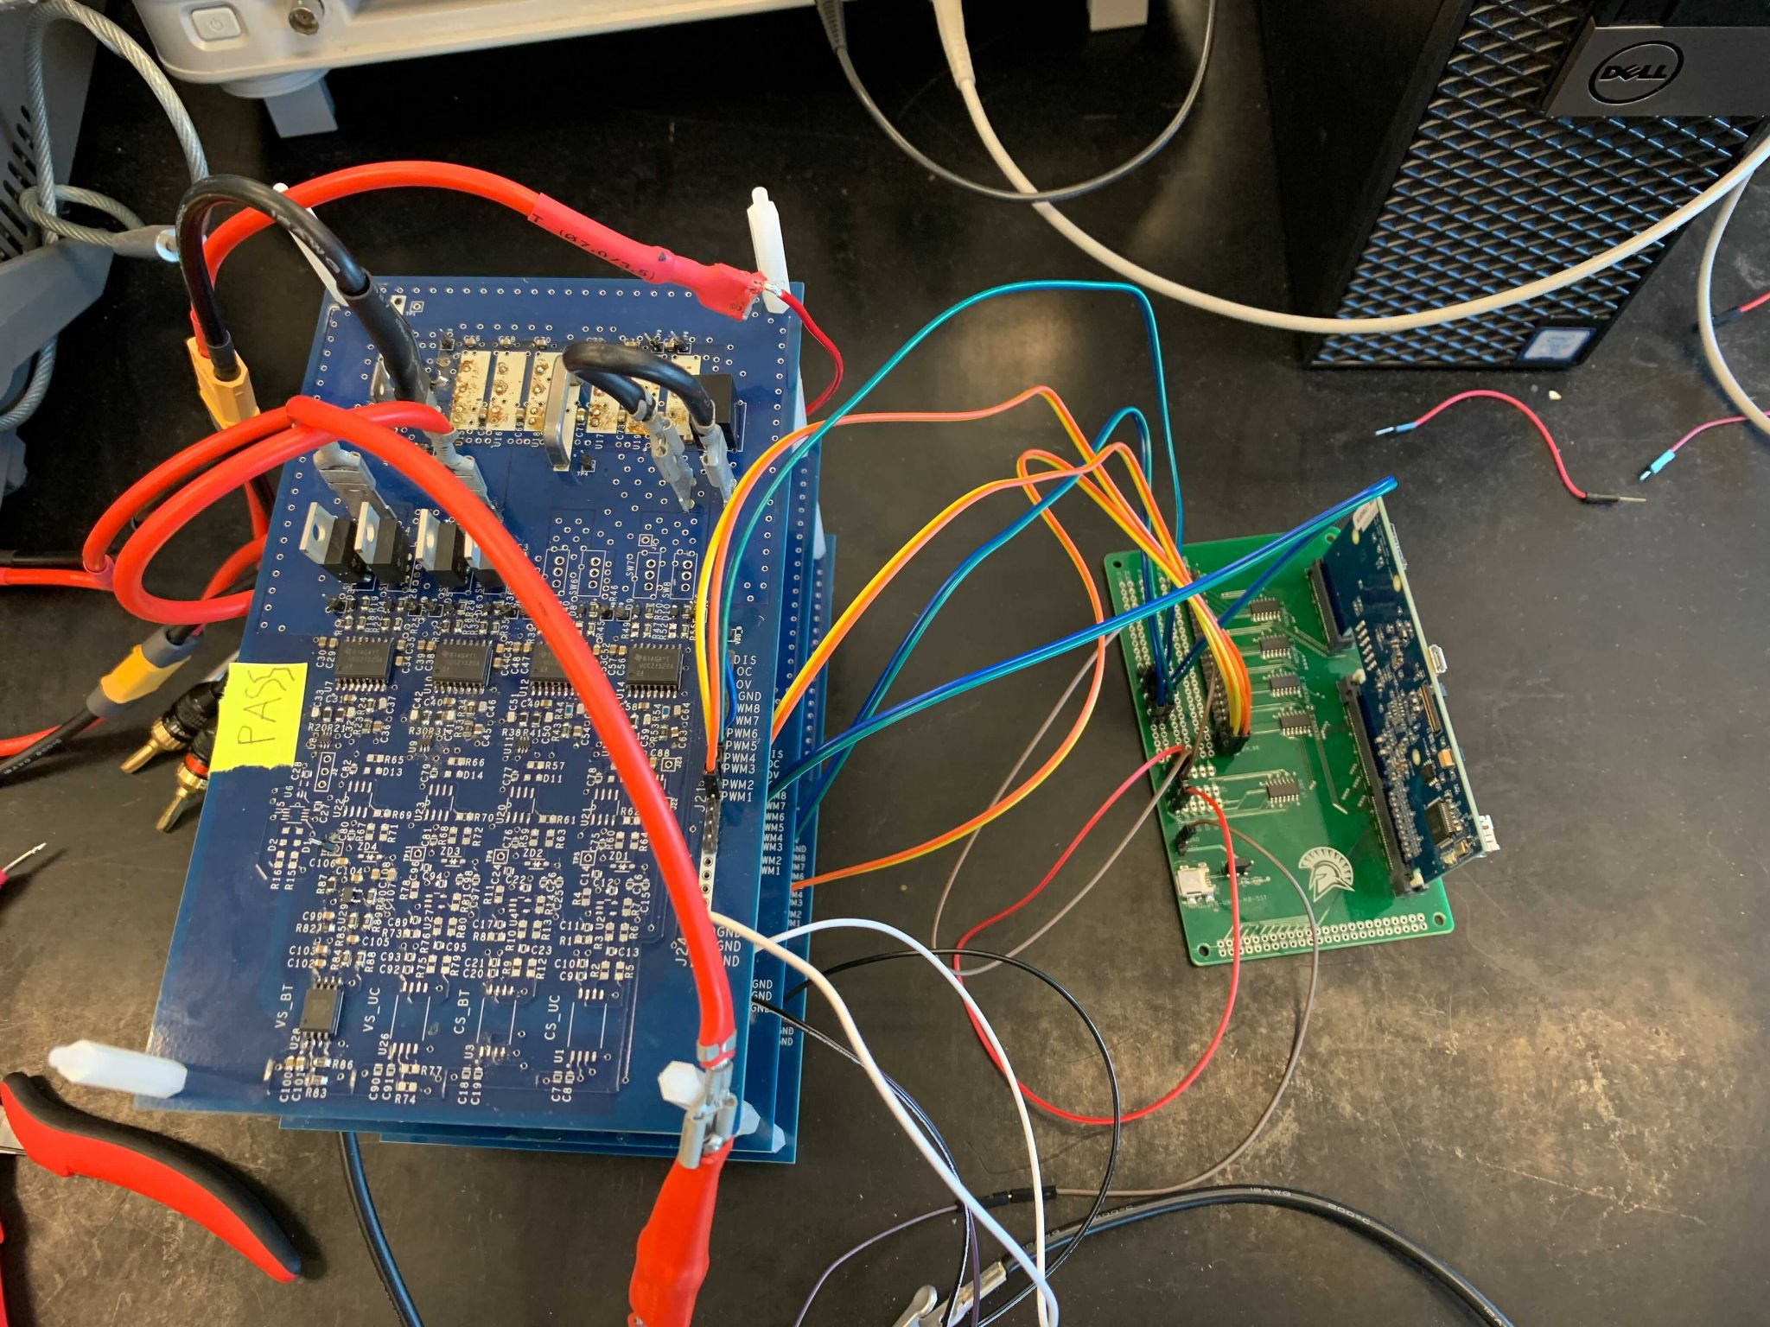
A. Current Hardware System
3 Multilevel Converter (MMC) Boards
Inverter
Old Current Sense
Old Voltage Sensor
Digital Signal Processor (DSP) Controller
Notes:
[A] : MMC
Contains old design of current sense
Designed a new current sense module
Designed a new voltage sensor module
Added LDO
[J] : DSP
_

Slide 7
III. Power Module Design
Notes:
[J] : (4mins)
_

Slide 8
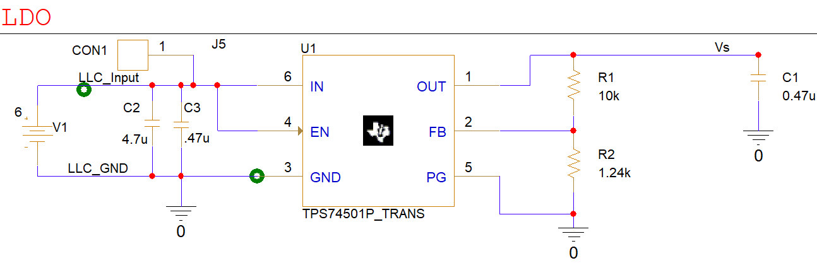
A. Current Sense Schematic (Pt. 1)
Notes:
[A] :
_

Slide 9
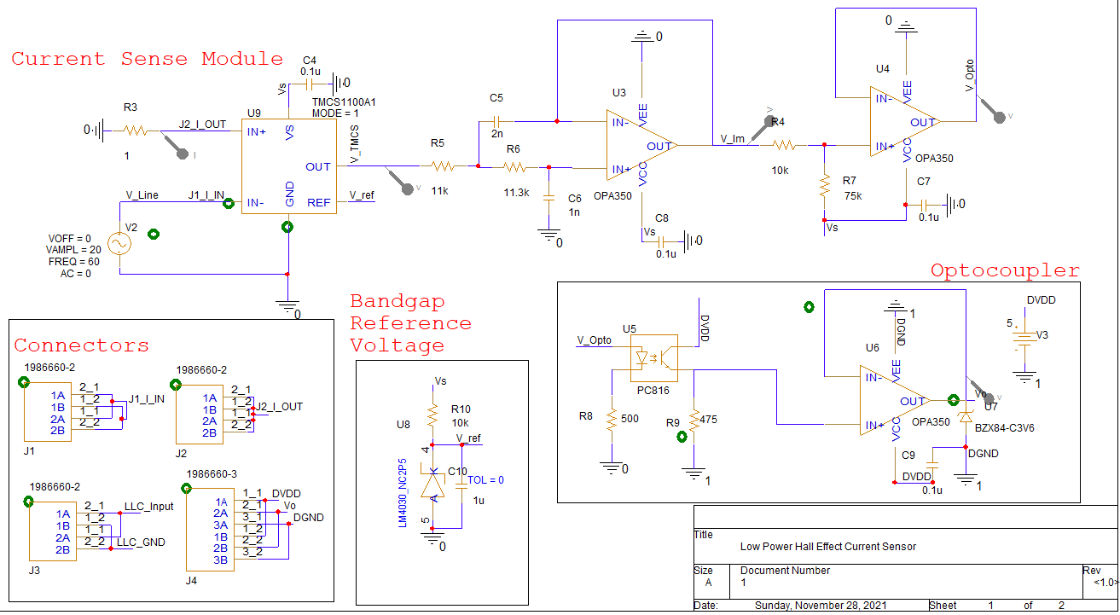
A. Current Sense Schematic (Pt. 2)
Notes:
[A] :
_

Slide 10
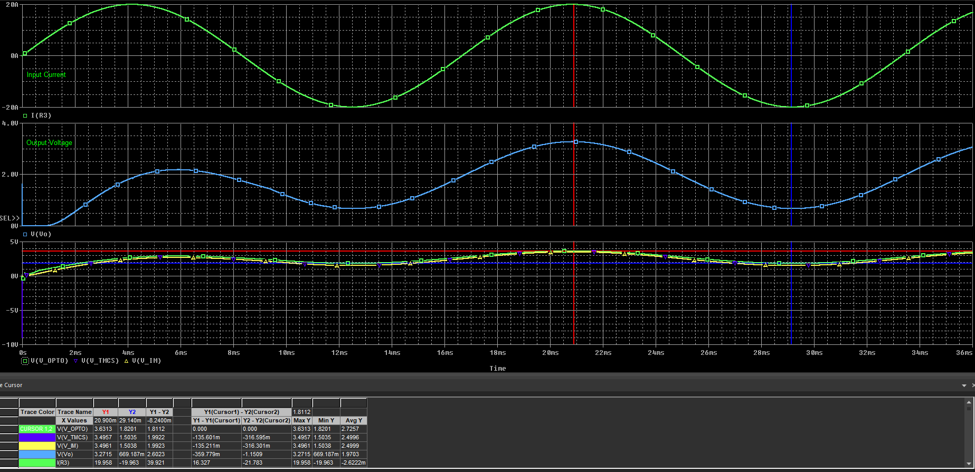
B. Simulation Results
Notes:
[A] : (6.5mins)
_

Slide 11
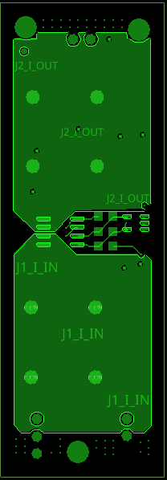
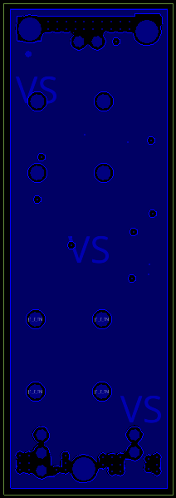
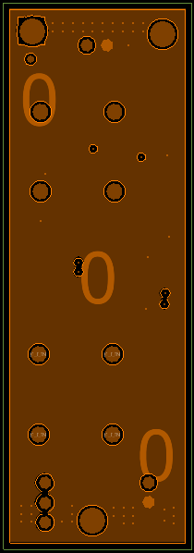
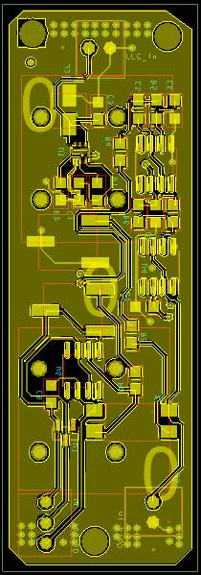
A. Current Sense PCB Layout (Pt. 1)
Top Layer
Power Layer
Ground Layer
Bottom Layer
Notes:
[H] : (9mins)
OrCad PCB Editor was the chosen PCB software
Powerful because of its low level functionality
Learned a lot about component searching, creating footprints, and working with PCB Editor with Capture
A lot of control on the minute detail of the board entirely
General design rules of PCB design goal of minimizing the footprint of the board
Packing components as closely as possible while also keeping in mind PCB design constraints
Follow the block layout of the schematic as closely as possible
Current Sense and Band gap reference voltage on top
Rest of Current Sense and block schematics on the bottom
Multiple iterations to reach this compact design
Design/manufacturing constraints from Bay Area Circuits
For our Current Sense Board specifically, along with general PCB design rules:
Balancing minimizing board foot print and spacing out components and traces
High Current requires calculated area polygon pours
Added via arrays, increased trace width, changed the copper weight on the outer layers to 2oz, added a ground plane to the bottom layer to maximize overall ground impedance to preserve the operation integrity of the components directly in contact with the high current polygon pours
Consider the mechanical limitations of the used components (trace width/through hole connectors/mounting holes)
Capabilities of Bay Area Circuits and consider the price ranges for advanced and basics
End Result: Current Sense Board that’s a 4 layer stackup, fits under the basics capabilities of the Bay Area circuits, and is the size of a thumb drive that can measure up to 20A

Slide 12
IV. Embedded Systems
Notes:
[H] :
_

Slide 13
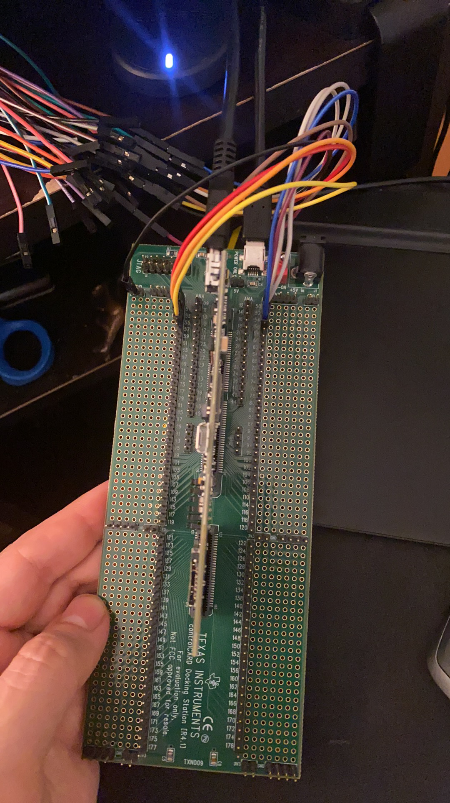
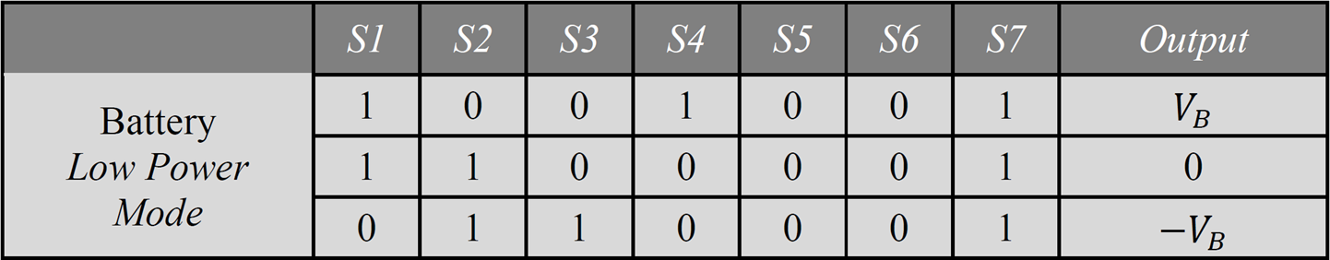
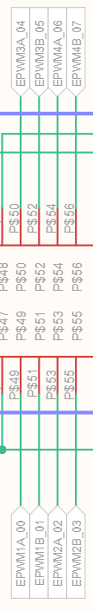
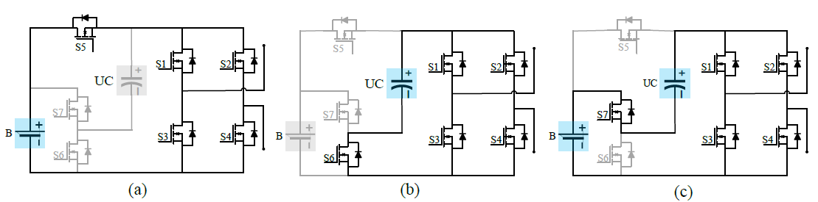
A. Digital Signal Processor (DSP) Pulse Width Modulated (PWM) Signals
[1]
Notes:
[J] :
_

Slide 14
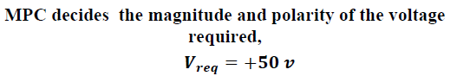
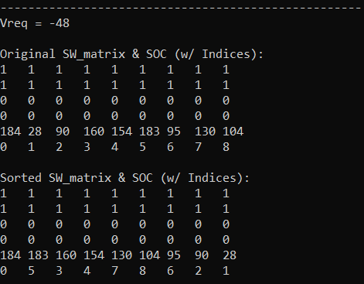
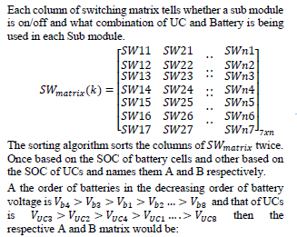
B. State of Charge (SOC) Adapted Sorting Algorithm (Pt. 1)
[1]
Notes:
[J] :
_

Slide 15
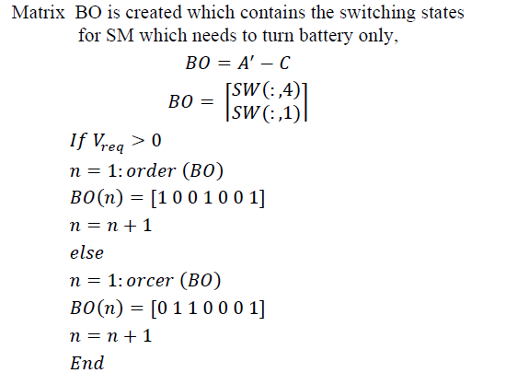
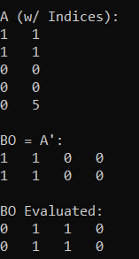
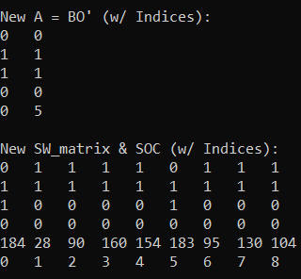
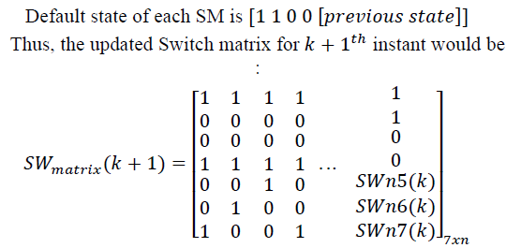
B. State of Charge (SOC) Adapted Sorting Algorithm (Pt. 2)
[1]
Notes:
[J] :
_

Slide 16
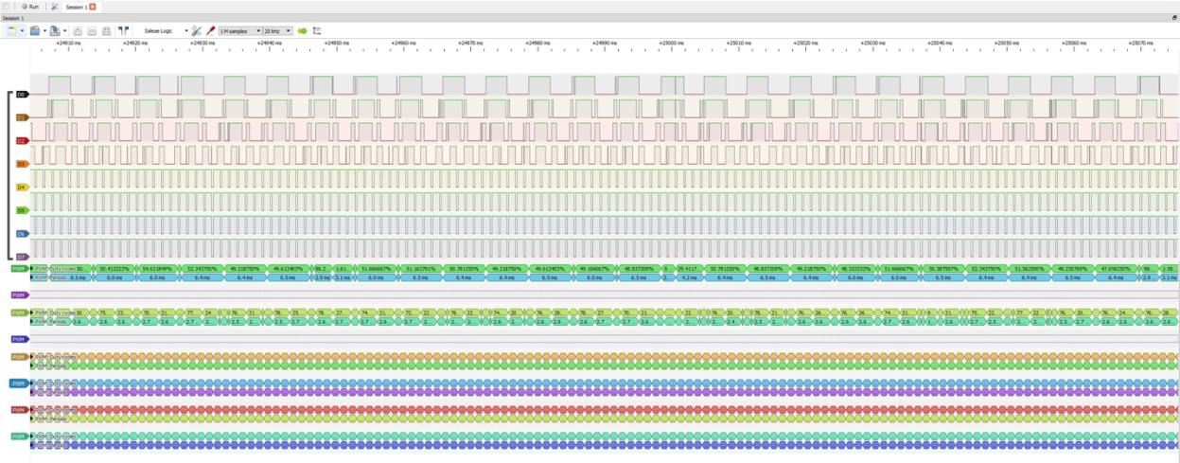
C. PWM waveforms with level 4 on DSP
Notes:
[J] :
_

Slide 17
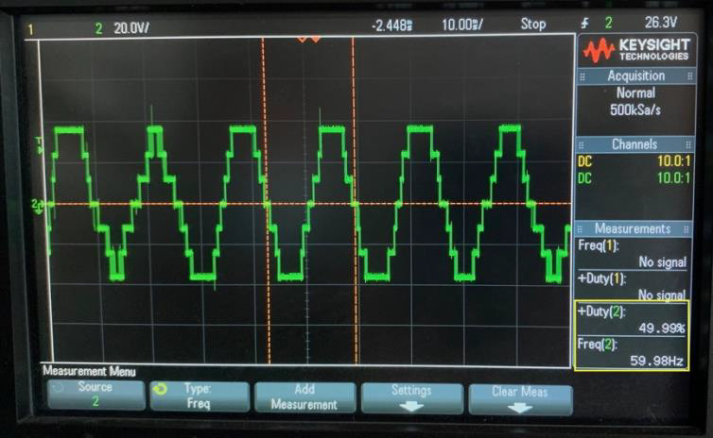
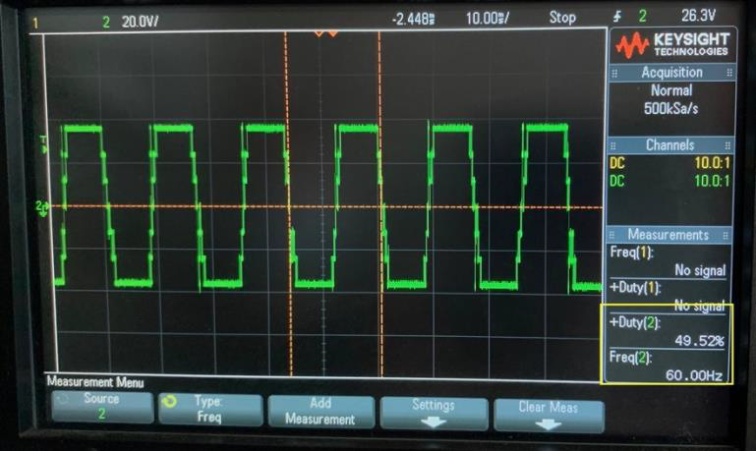
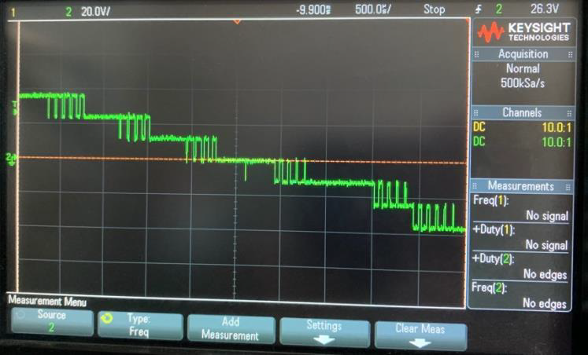
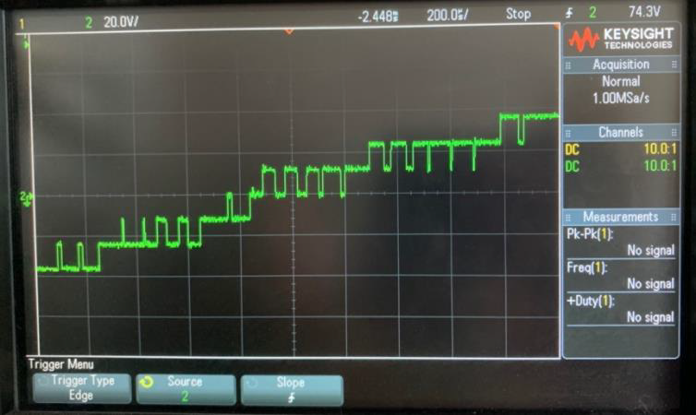
C. Waveforms before and after SOC Algorithm
Notes:
[J] :
_

Slide 18
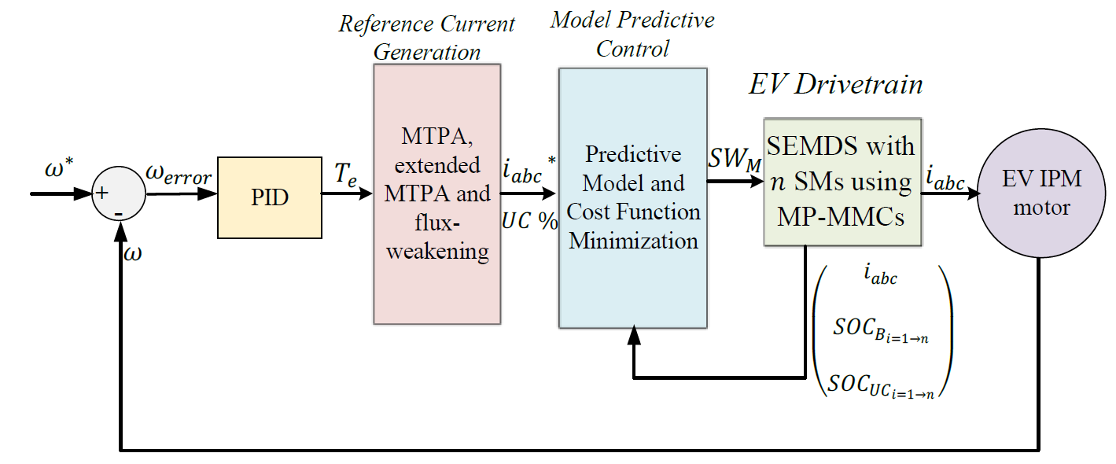
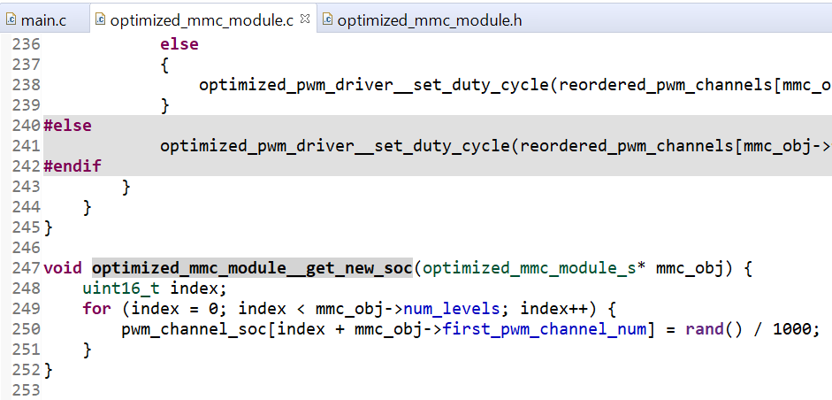
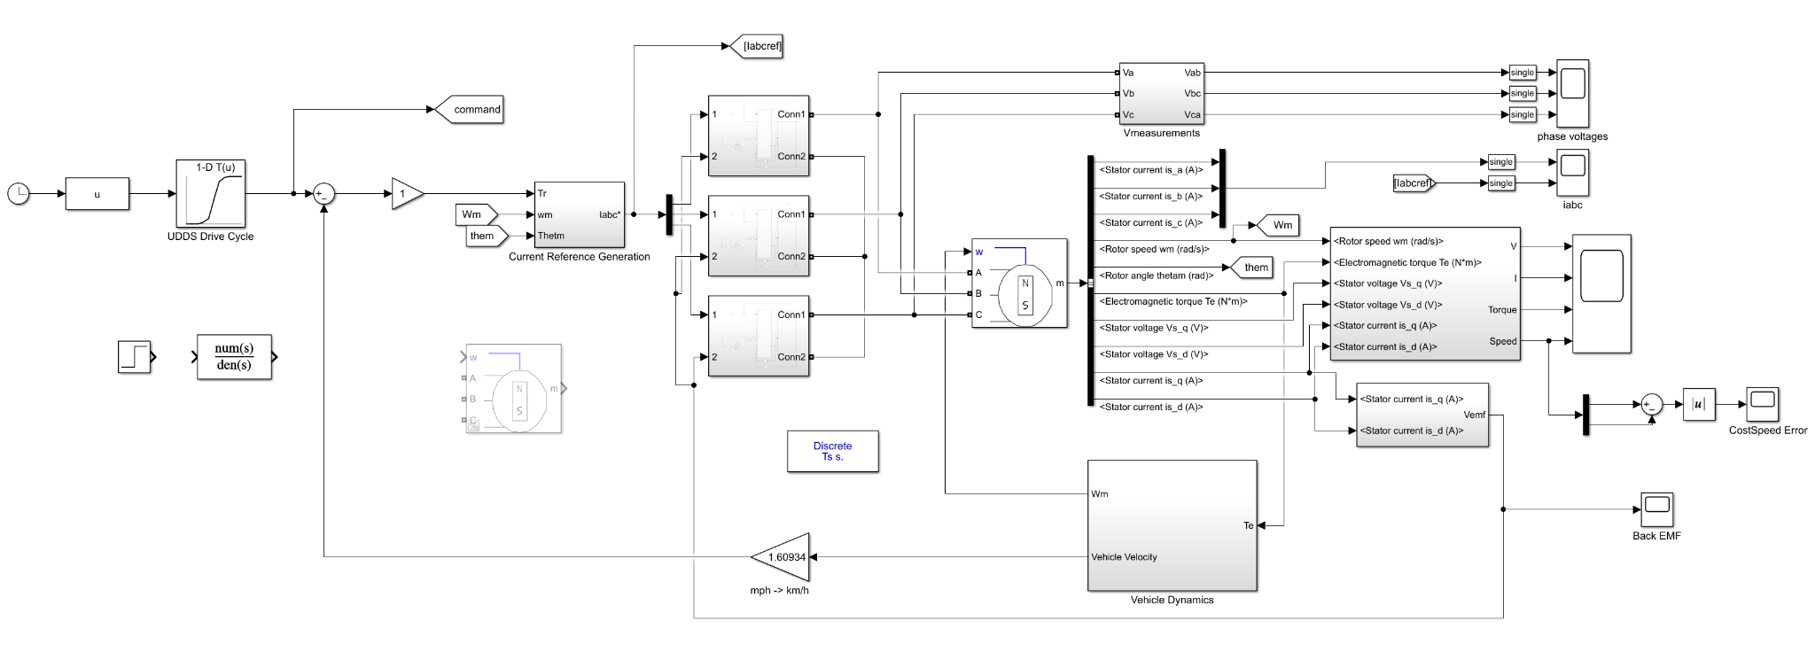
D. Kalman Filter Research (Pt. 1)
[1]
Notes:
[J] :
_

Slide 19
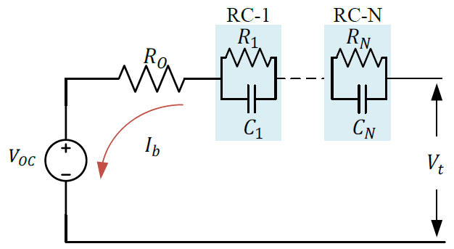
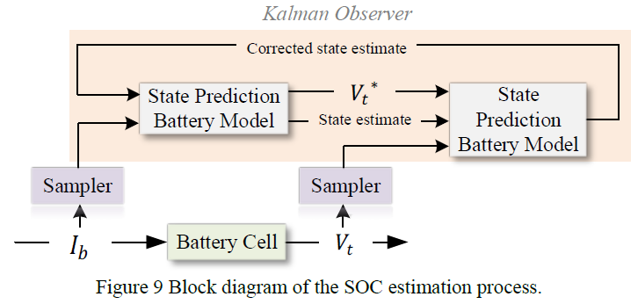
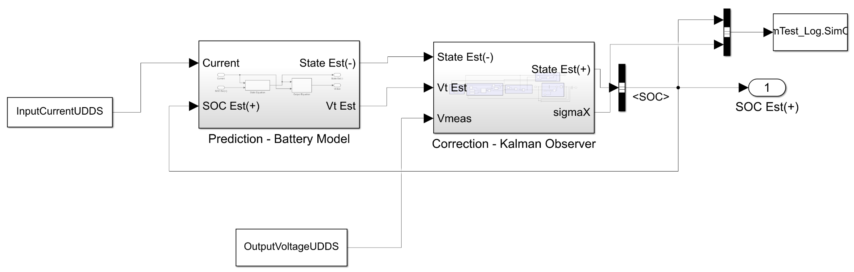
D. Kalman Filter Research (Pt. 2)
[1]
Notes:
[J] :
_

Slide 20

V. Future Work and Considerations
Power Module Design
Consider different methods to provide isolation between circuits
Embedded Systems
Continue to implement and improve MPC functionality
Combine MATLAB simulink files to study behavior
Adapt Kalman Filter model into C code for implementation
Notes:
[J] : ES (12.5mins)
[A/H] : PMD
_

Slide 21
References
[1] M. Badawy, M. Sharma, C. Hernandez, A. Elrayyah and J. Coe, "Model Predictive Control for Multi-Port Modular Multilevel Converters in Electric Vehicles Enabling HESDs", IEEE Transactions on Energy Conversion, pp. 1-1, 2021. Available: <https://ieeexplore-ieee-org.libaccess.sjlibrary.org/document/9457037> [Accessed 29 November 2021].
[2] T. Randall, "Here’s How Electric Cars Will Cause the Next Oil Crisis", Bloomberg.com, 2016. [Online]. Available: <https://www.bloomberg.com/features/2016-ev-oil-crisis/> [Accessed: 08 May 2021].
Notes:
[J] :
_

Slide 22

Questions
Notes:
[J] :
_

